Slide 1

Spring AI
Dima Ionut Daniel

Slide 2
Contents
What is Spring AI?
History
Features
Goals
Concepts
Core
ChatMemory
Tool Calling
VectorStore
MCP
Conclusion
Bibliography

Slide 3

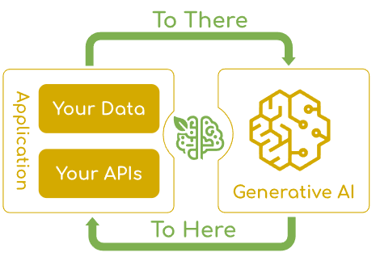
What is Spring AI?
Java Spring AI is an application framework and starter library under the Spring ecosystem designed to simplify the integration of artificial intelligence (AI) capabilities—especially those based on large language models (LLMs)—into Spring Boot applications.
Its main goal is to apply Spring’s core principles like modularity, portability, and POJO-centric design to AI engineering, allowing developers to build AI-powered features with ease and consistency.

Slide 4
History
Spring AI was introduced around 2024–2025 as a dedicated AI-focused framework under the Spring umbrella, aiming to simplify AI integration for Java developers.
It builds upon the success and architecture of the Spring Framework and Spring Boot, applying modularity, consistent APIs, and Spring idioms to AI technologies.
Spring AI focuses on providers like OpenAI, Hugging Face, Ollama, and others, unifying various AI model integrations under a common programming model.

Slide 5
Features
Multi-provider support: Easy switching and abstraction over AI providers such as OpenAI, Azure, Hugging Face, Ollama, and more.
Unified Chat Client API: A fluent interface for communicating with chat-based AI models regardless of provider differences.
Prompt Templates: Dynamic prompts with placeholders, leveraging Spring Expression Language.
Embeddings & Vector Store Integration: Support for converting text to embeddings and storing in vector databases.
Structured Output Mapping: Automatic conversion of AI responses into Java POJOs.
Advanced AI patterns: Tool calling, retrieval-augmented generation (RAG), and model context management.

Slide 6
Goals
Simplify AI-enabled application development for Java developers by providing a set of abstractions tailored for AI applications, including runtime configuration for using popular AI models and data sources, both proprietary and open-source.
Enable seamless integration of a wide range of AI providers (e.g., OpenAI, Anthropic, Microsoft, Hugging Face, Ollama) with a unified API for chat, embeddings, text-to-image, and other AI model interactions.
Empower Java developers, regardless of AI expertise, to create intelligent AI-powered applications quickly and easily by lowering the barrier of entry, supporting multiple implementations, and ensuring minimal code changes for swapping components.

Slide 7
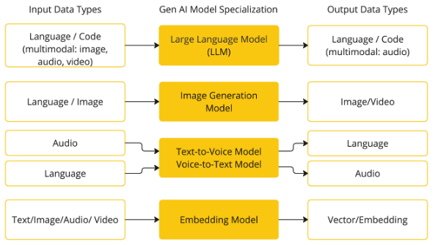
Concepts
Models
AI models are algorithms designed to process and generate information, often mimicking human cognitive functions.
There are many different types of AI models, each suited for a specific use case.
Spring AI currently supports models that process input and output as language, image, and audio.

Slide 8
Concepts (cont.)
Prompts
Prompts serve as the foundation for the language-based inputs that guide an AI model to produce specific outputs.
Crafting effective prompts is both an art and a science. Such is the importance of this interaction style that the term "Prompt Engineering" has emerged as its own discipline.
There is a burgeoning collection of techniques that improve the effectiveness of prompts. Investing time in crafting a prompt can drastically improve the resulting output.
Sharing prompts has become a communal practice, and there is active academic research being done on this subject.

Slide 9
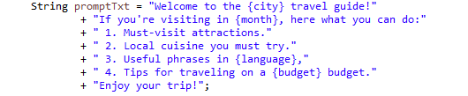
Concepts (cont.)
Prompt Templates
Creating effective prompts involves establishing the context of the request and substituting parts of the request with values specific to the user’s input.
This process uses traditional text-based template engines for prompt creation and management.
In Spring AI, prompt templates can be likened to the "View" in Spring MVC architecture. A model object, typically a java.util.Map, is provided to populate placeholders within the template. The "rendered" string becomes the content of the prompt supplied to the AI model.

Slide 10
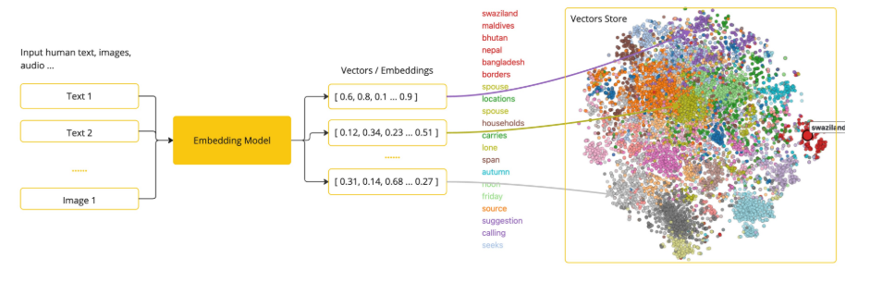
Concepts (cont.)
Embeddings
Embeddings are numerical representations of text, images, or videos that capture relationships between inputs.
Embeddings work by converting text, image, and video into arrays of floating point numbers, called vectors.
These vectors are designed to capture the meaning of the text, images, and videos. The length of the embedding array is called the vector’s dimensionality.
By calculating the numerical distance between the vector representations of two pieces of text, an application can determine the similarity between the objects used to generate the embedding vectors.

Slide 11
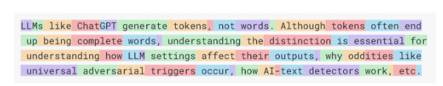
Concepts (cont.)
Tokens
Tokens serve as the building blocks of how an AI model works. On input, models convert words to tokens. On output, they convert tokens back to words.
In English, one token roughly corresponds to 75% of a word.
Perhaps more important is that Tokens = Money. In the context of hosted AI models, your charges are determined by the number of tokens used. Both input and output contribute to the overall token count.
Models are subject to token limits, which restrict the amount of text processed in a single API call. This threshold is often referred to as the "context window". The model does not process any text that exceeds this limit.
ChatGPT3 has a 4K token limit, while GPT4 offers varying options, such as 8K, 16K, and 32K. Anthropic’s Claude AI model features a 100K token limit, and Meta’s recent research yielded a 1M token limit model.

Slide 12
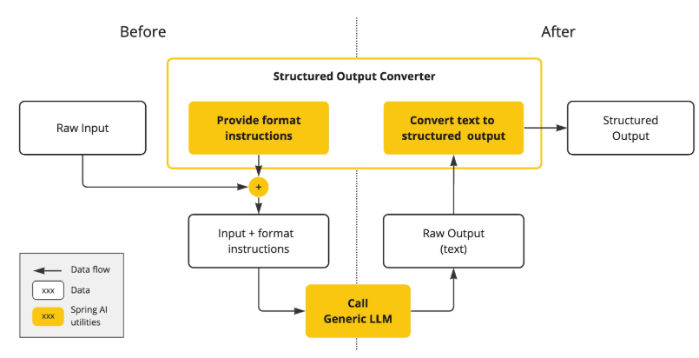
Concepts (cont.)
Structured Output
The output of AI models traditionally arrives as a java.lang.String, even if you ask for the reply to be in JSON.
The Structured output conversion employs meticulously crafted prompts, often necessitating multiple interactions with the model to achieve the desired formatting.

Slide 13
Concepts (cont.)
How can you equip the AI model with information on which it has not been trained?
Three techniques exist for customizing the AI model to incorporate your data:
Fine Tuning:
This traditional machine learning technique involves tailoring the model and changing its internal weighting. However, it is a challenging process for machine learning experts and extremely resource-intensive for models like GPT due to their size. Additionally, some models might not offer this option.
Prompt Stuffing:
A more practical alternative involves embedding your data within the prompt provided to the model. Given a model’s token limits, techniques are required to present relevant data within the model’s context window. This approach is colloquially referred to as “stuffing the prompt.” The Spring AI library helps you implement solutions based on the “stuffing the prompt” technique otherwise known as Retrieval Augmented Generation (RAG).
Tool Calling:
This technique allows registering tools (user-defined services) that connect the large language models to the APIs of external systems. Spring AI greatly simplifies code you need to write to support tool calling.

Slide 14
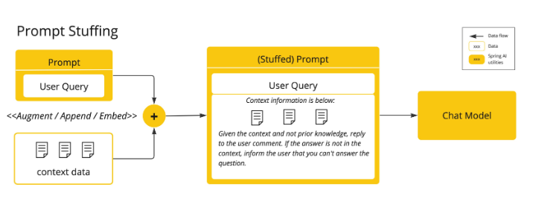
Concepts (cont.)

Slide 15
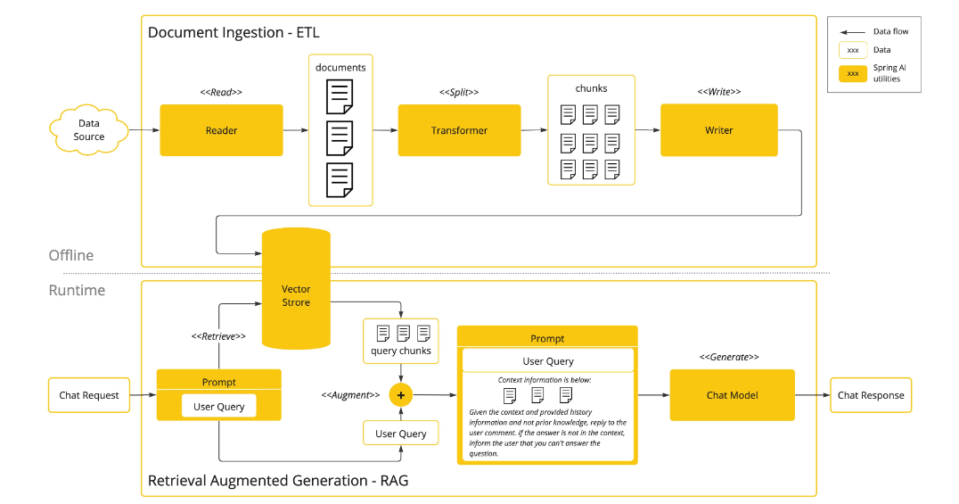
Concepts (cont.)

Slide 16
Concepts (cont.)
Retrieval Augmented Generation (RAG) has emerged to address the challenge of incorporating relevant data into prompts for accurate AI model responses.
it involves a batch processing style programming model, where the job reads unstructured data from your documents, transforms it, and then writes it into a vector database.
At a high level, this is an ETL (Extract, Transform and Load) pipeline. The vector database is used in the retrieval part of RAG technique.
The procedure of splitting the original document into smaller pieces has two important steps:
Split the document into parts while preserving the semantic boundaries of the content.
Split the document’s parts further into parts whose size is a small percentage of the AI Model’s token limit.

Slide 17
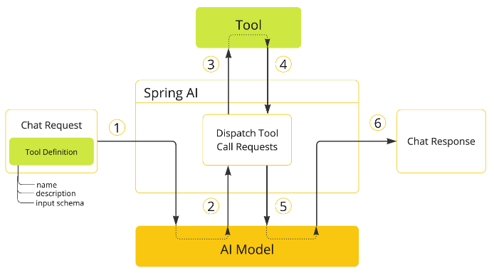
Concepts (cont.)
The Tool Calling mechanism addresses allows you to register your own services as tools to connect the large language models to the APIs of external systems. These systems can provide LLMs with real-time data and perform data processing actions on their behalf.
When we want to make a tool available to the model, we include its definition in the chat request.
When the model decides to call a tool, it sends a response with the tool name and the input parameters modeled after the defined schema.
The application is responsible for using the tool name to identify and execute the tool with the provided input parameters.
The result of the tool call is processed by the application.
The application sends the tool call result back to the model.
The model generates the final response using the tool call result as additional context.

Slide 18
Core
The ChatClient offers a fluent API for communicating with an AI Model. It supports both a synchronous and streaming programming model.
The fluent API has methods for building up the constituent parts of a Prompt that is passed to the AI model as input.
The AI model processes two main types of messages: user messages, which are direct inputs from the user, and system messages, which are generated by the system to guide the conversation.
The ChatClient is created using a ChatClient.Builder object. You can obtain an autoconfigured ChatClient.Builder instance for any ChatModel Spring Boot autoconfiguration or create one programmatically.
The call() method sends a request to the AI model, and the content() method returns the AI model’s response as a String.

Slide 19
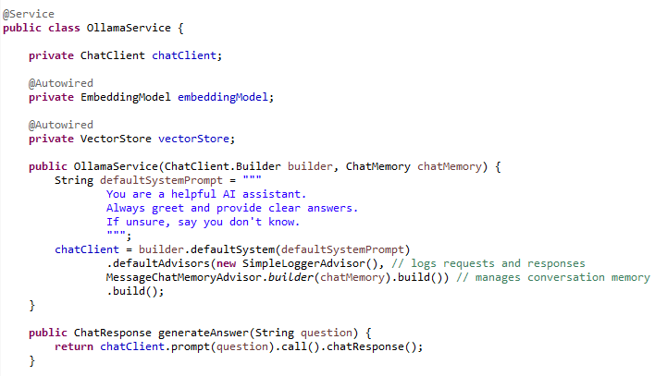
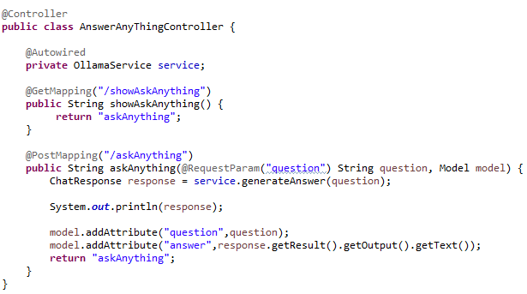
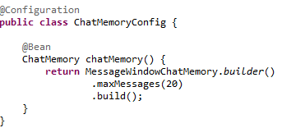
Core (cont.)

Slide 20
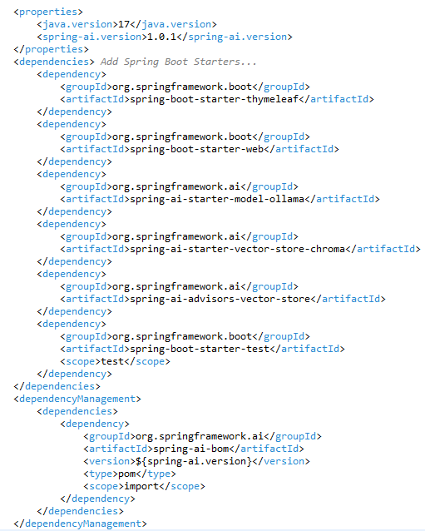
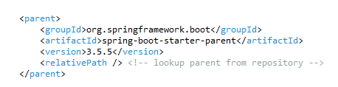
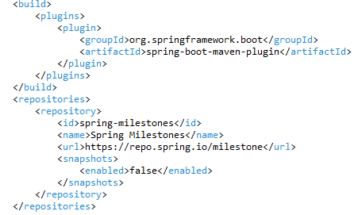
Core (cont.)

Slide 21
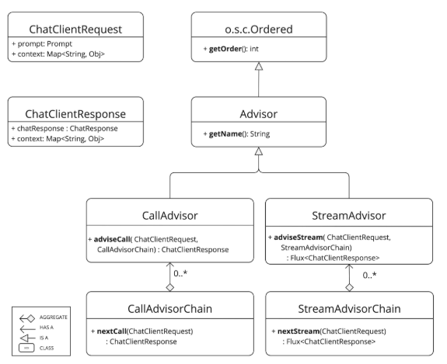
Core (cont.)
The Spring AI Advisors API provides a flexible and powerful way to intercept, modify, and enhance AI-driven interactions in your Spring applications.
The API consists of CallAdvisor and CallAdvisorChain for non-streaming scenarios, and StreamAdvisor and StreamAdvisorChain for streaming scenarios.

Slide 22
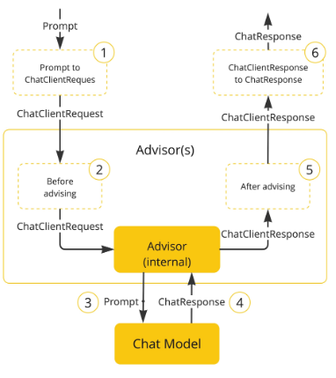
Core (cont.)
Following flow diagram illustrates the interaction between the advisor chain and the Chat Model:

Slide 23
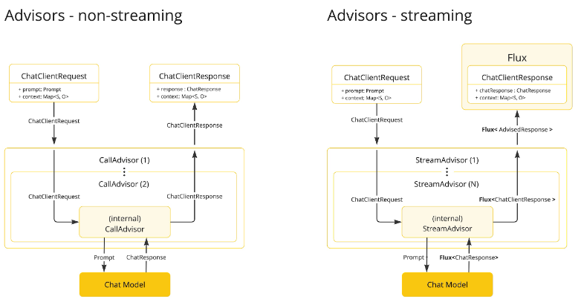
Core (cont.)
Streaming vs Non-Streaming

Slide 24
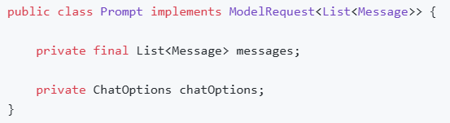
Core (cont.)
Prompts are the inputs that guide an AI model to generate specific outputs.
The Prompt class functions as a container for an organized series of Message objects and a request ChatOptions
Every Message embodies a unique role within the prompt, differing in its content and intent.

Slide 25
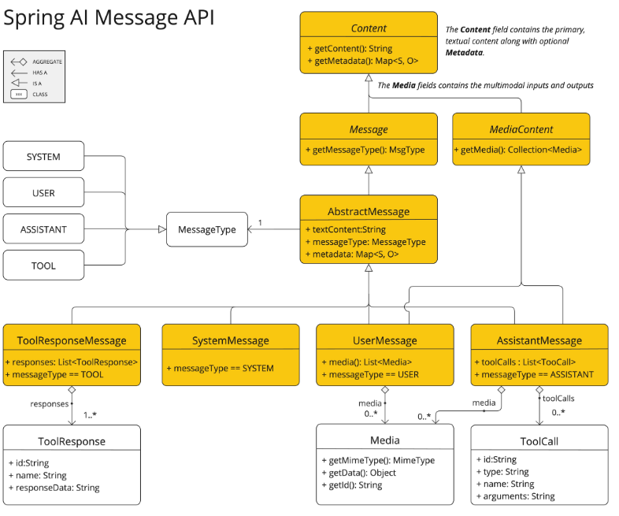
Core (cont.)
Various implementations of the Message interface correspond to different categories of messages that an AI model can process. The Models distinguish between message categories based on conversational roles.

Slide 26
Core (cont.)
The primary roles are:
System Role: Guides the AI’s behavior and response style, setting parameters or rules for how the AI interprets and replies to the input. It’s akin to providing instructions to the AI before initiating a conversation.
User Role: Represents the user’s input – their questions, commands, or statements to the AI. This role is fundamental as it forms the basis of the AI’s response.
Assistant Role: The AI’s response to the user’s input. More than just an answer or reaction, it’s crucial for maintaining the flow of the conversation. By tracking the AI’s previous responses (its 'Assistant Role' messages), the system ensures coherent and contextually relevant interactions. The Assistant message may contain Function Tool Call request information as well. It’s like a special feature in the AI, used when needed to perform specific functions such as calculations, fetching data, or other tasks beyond just talking.
Tool/Function Role: The Tool/Function Role focuses on returning additional information in response to Tool Call Assistant Messages.

Slide 27
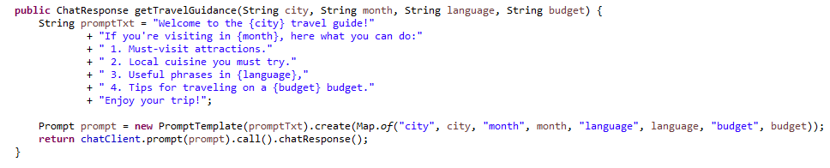
Core (cont.)
Example using prompt template with parameters

Slide 28
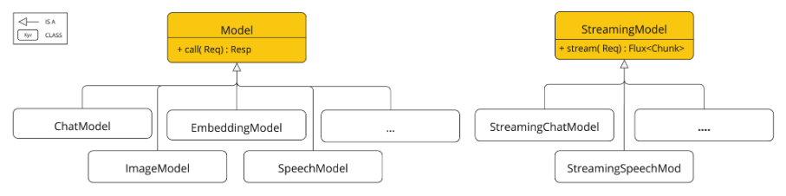
Core (cont.)
Portable Model API across AI providers for Chat, Text to Image, Audio Transcription, Text to Speech, and Embedding models.
Both synchronous and stream API options are supported.

Slide 29
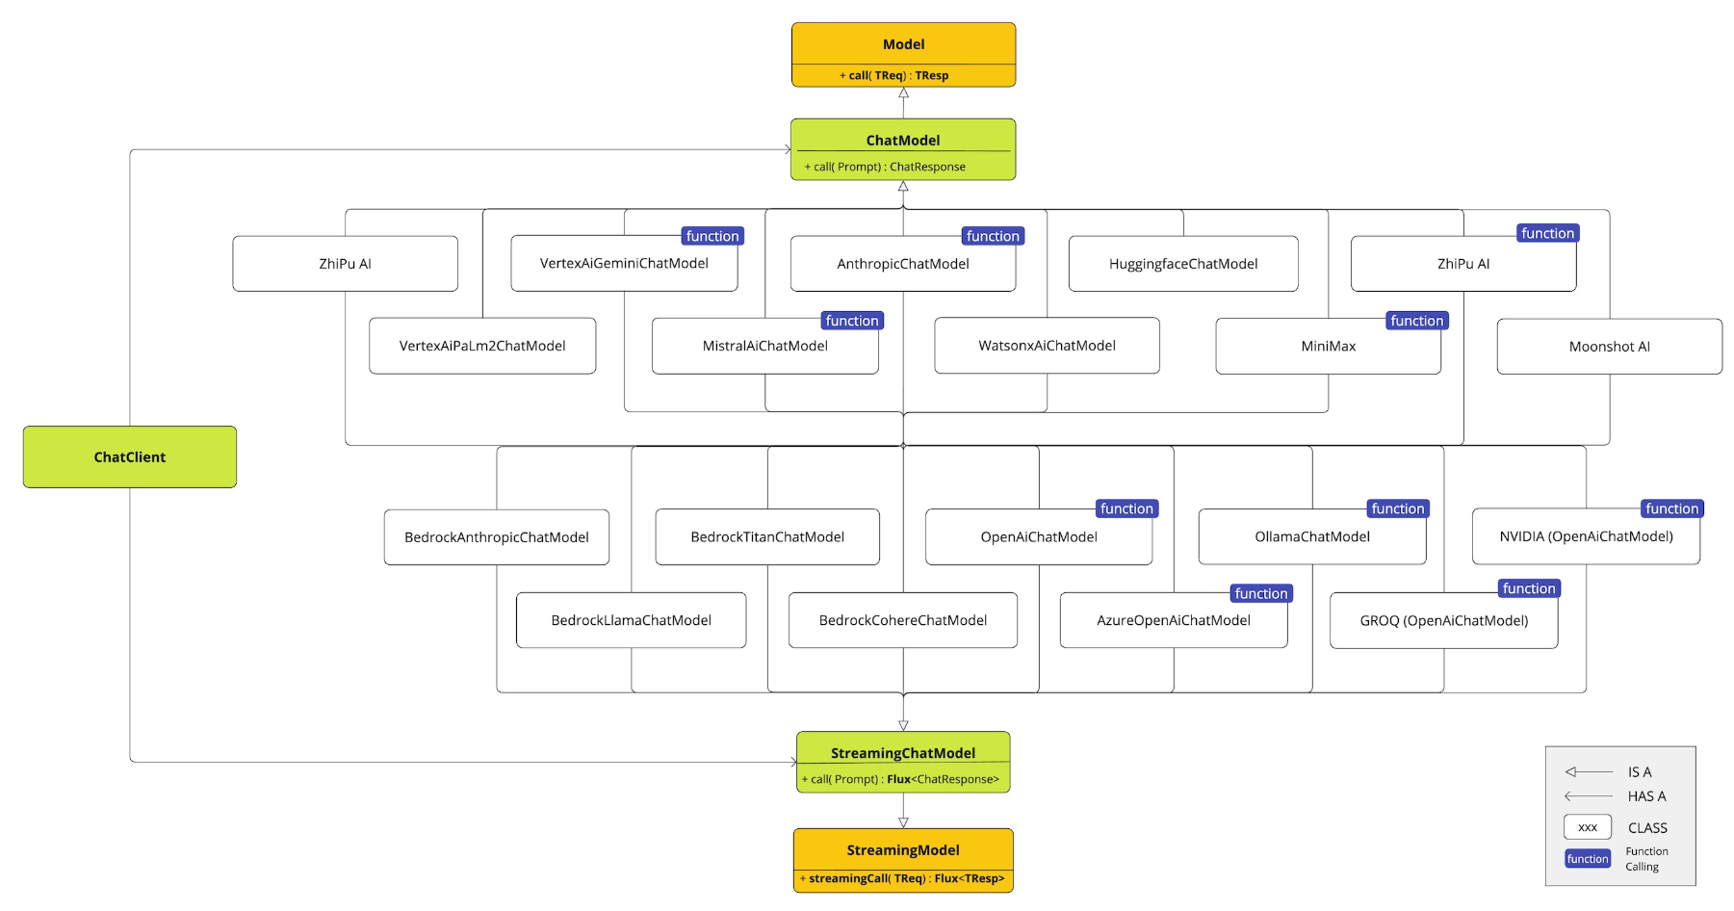
Core (cont.)

Slide 30
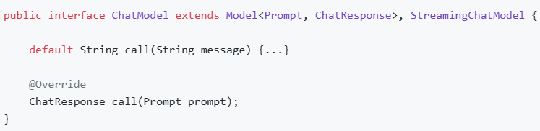
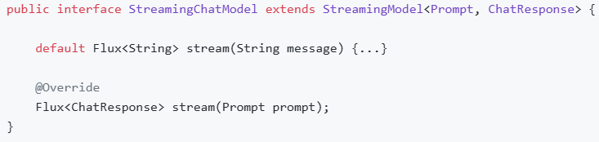
Core (cont.)
The Chat Model API offers developers the ability to integrate AI-powered chat completion capabilities into their applications.
The API typically works by sending a prompt or partial conversation to the AI model, which then generates a completion or continuation of the conversation based on its training data and understanding of natural language patterns. The completed response is then returned to the application, which can present it to the user or use it for further processing.

Slide 31
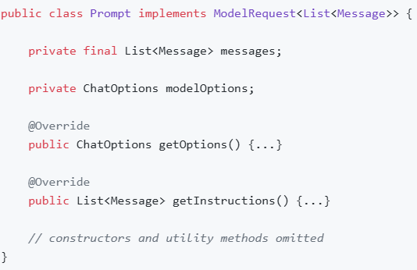
Core (cont.)
The Prompt is a ModelRequest that encapsulates a list of Message objects and optional model request options.

Slide 32
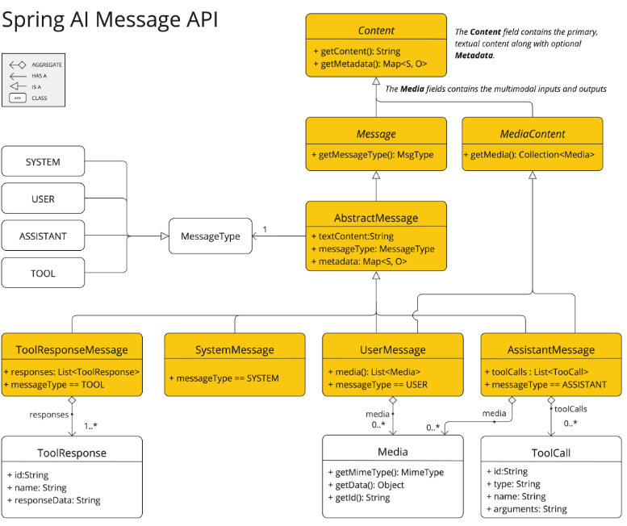
Core (cont.)

Slide 33
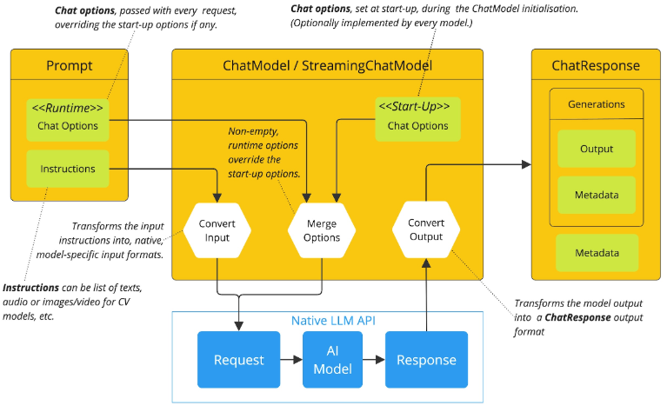
Core (cont.)
Spring AI handles the configuration and execution of Chat Models, combining start-up and runtime option.

Slide 34
Core (cont.)
The Embedding Model API is built on top of the generic Spring AI Model API, which is a part of the Spring AI library.
The EmbeddingModel interface extends the Model interface, which provides a standard set of methods for interacting with AI models.
The EmbeddingRequest and EmbeddingResponse classes extend from the ModelRequest and ModelResponse are used to encapsulate the input and output of the embedding models, respectively.
The Embedding API in turn is used by higher-level components to implement Embedding Models for specific embedding models, such as OpenAI, Titan, Azure OpenAI, Ollie, and others.

Slide 35
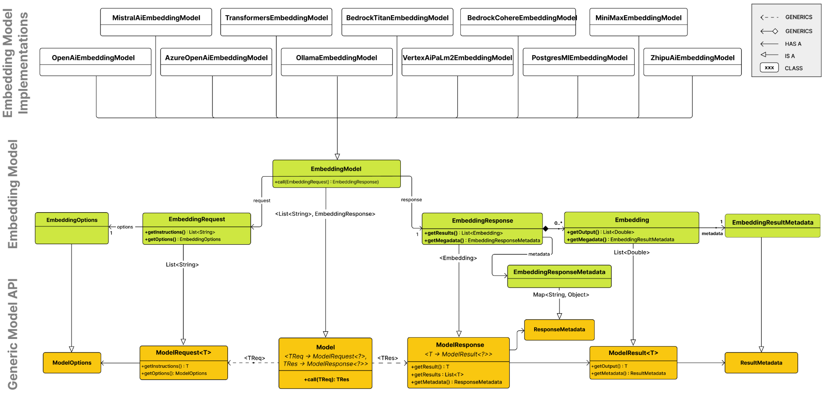
Core (cont.)

Slide 36
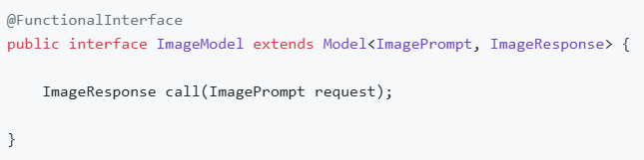
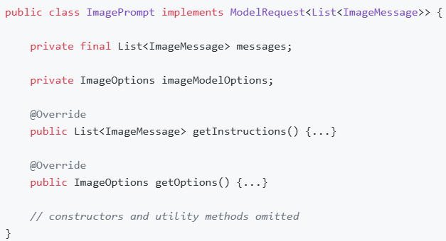
Core (cont.)
The Spring Image Model API is designed to be a simple and portable interface for interacting with various AI Models specialized in image generation.
The Spring Image Model API is built on top of the Spring AI Generic Model API, providing image-specific abstractions and implementations.

Slide 37
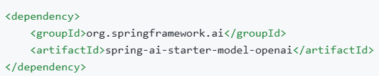
Core (cont.)
Spring AI provides support for OpenAI’s Transcription API. We need to create an API key with OpenAI to access ChatGPT models.
Spring AI provides Spring Boot auto-configuration for the OpenAI Transcription Client.
o enable it add the following dependency to your project’s Maven pom.xml file:

Slide 38
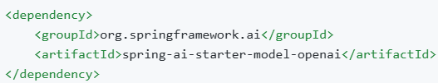
Core (cont.)
Spring AI provides support for OpenAI’s Speech API.
The Audio API provides a speech endpoint based on OpenAI’s TTS (text-to-speech) model, enabling users to:
Narrate a written blog post.
Produce spoken audio in multiple languages.
Give real-time audio output using streaming.
Spring AI provides Spring Boot auto-configuration for the OpenAI Text-to-Speech Client.

Slide 39
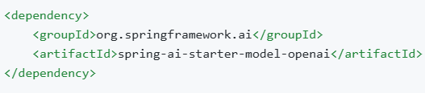
Core (cont.)
Spring AI supports OpenAI’s Moderation model, which allows you to detect potentially harmful or sensitive content in text.
Spring AI provides Spring Boot auto-configuration for the OpenAI Moderation Model.

Slide 40
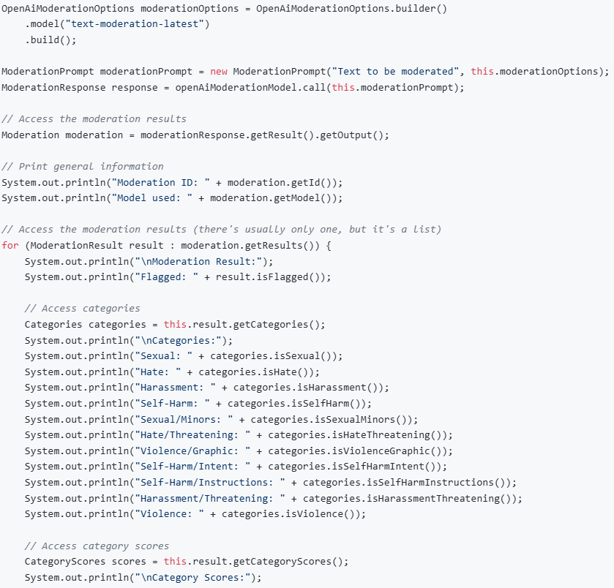
Core (cont.)

Slide 41
ChatMemory
Large language models (LLMs) are stateless, meaning they do not retain information about previous interactions.
Spring AI provides chat memory features that allow you to store and retrieve information across multiple interactions with the LLM.
The ChatMemory abstraction allows you to implement various types of memory to support different use cases.
Chat Memory: the information that a large-language model retains and uses to maintain contextual awareness throughout a conversation.
Chat History: the entire conversation history, including all messages exchanged between the user and the model.

Slide 42

ChatMemory (cont.)
MessageWindowChatMemory maintains a window of messages up to a specified maximum size.
When the number of messages exceeds the maximum, older messages are removed while preserving system messages.
The default window size is 20 messages.

Slide 43
ChatMemory (cont.)
Spring AI offers the ChatMemoryRepository abstraction for storing chat memory.
Spring AI supports multiple relational databases via a dialect abstraction. The following databases are supported out-of-the-box:
PostgreSQL
MySQL / MariaDB
SQL Server
HSQLDB

Slide 44
Tool Calling
Tool calling (also known as function calling) is a common pattern in AI applications allowing a model to interact with a set of APIs, or tools, augmenting its capabilities.
Tools are mainly used for:
Information Retrieval. Tools in this category can be used to retrieve information from external sources, such as a database, a web service, a file system, or a web search engine. The goal is to augment the knowledge of the model, allowing it to answer questions that it would not be able to answer otherwise. As such, they can be used in Retrieval Augmented Generation (RAG) scenarios. For example, a tool can be used to retrieve the current weather for a given location, to retrieve the latest news articles, or to query a database for a specific record.
Taking Action. Tools in this category can be used to take action in a software system, such as sending an email, creating a new record in a database, submitting a form, or triggering a workflow. The goal is to automate tasks that would otherwise require human intervention or explicit programming. For example, a tool can be used to book a flight for a customer interacting with a chatbot, to fill out a form on a web page, or to implement a Java class based on an automated test (TDD) in a code generation scenario.

Slide 45
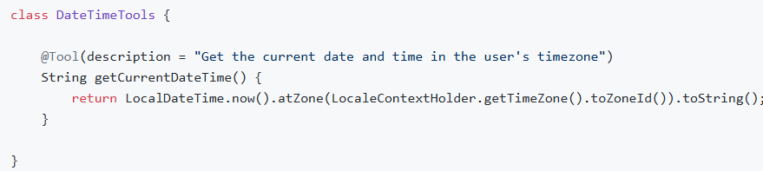
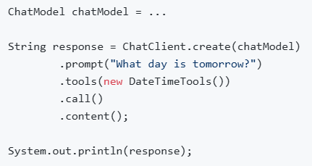
Tool Calling (cont.)
AI models don’t have access to real-time information.
Any question that assumes awareness of information such as the current date or weather forecast cannot be answered by the model.
We can provide a tool that can retrieve this information, and let the model call this tool when access to real-time information is needed.

Slide 46
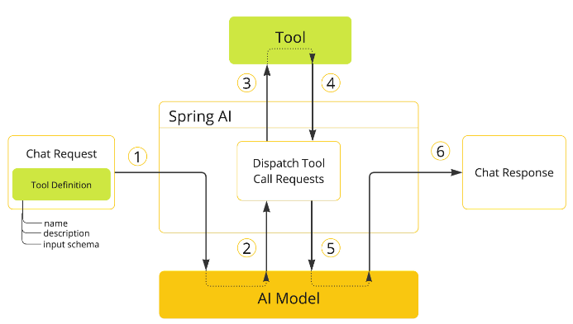
Tool Calling (cont.)
Spring AI supports tool calling through a set of flexible abstractions that allow you to define, resolve, and execute tools in a consistent way.
When we want to make a tool available to the model, we include its definition in the chat request. Each tool definition comprises of a name, a description, and the schema of the input parameters.
When the model decides to call a tool, it sends a response with the tool name and the input parameters modeled after the defined schema.
The application is responsible for using the tool name to identify and execute the tool with the provided input parameters.
The result of the tool call is processed by the application.
The application sends the tool call result back to the model.
The model generates the final response using the tool call result as additional context.

Slide 47
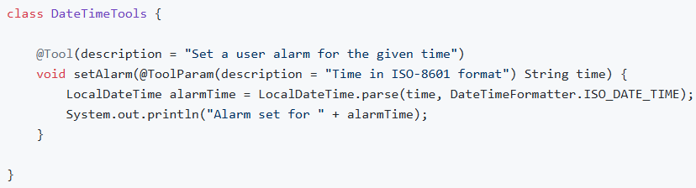
Tool Calling (cont.)
Spring AI will generate the JSON schema for the input parameters of the @Tool-annotated method automatically.
The schema is used by the model to understand how to call the tool and prepare the tool request.
The @ToolParam annotation can be used to provide additional information about the input parameters, such as a description or whether the parameter is required or optional. By default, all input parameters are considered required. :

Slide 48
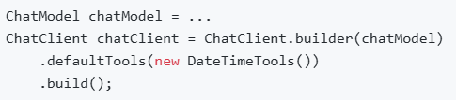
Tool Calling (cont.)
When using the declarative specification approach, you can add default tools to a ChatClient.Builder by passing the tool class instance to the defaultTools() method.
If both default and runtime tools are provided, the runtime tools will completely override the default tools.

Slide 49
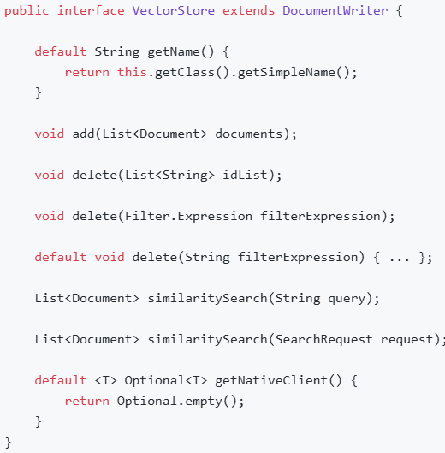
VectorStore
A vector database is a specialized type of database that plays an essential role in AI applications.
In vector databases, queries differ from traditional relational databases. Instead of exact matches, they perform similarity searches. When given a vector as a query, a vector database returns vectors that are “similar” to the query vector.

Slide 50
VectorStore (cont.)
To insert data into the vector database, encapsulate it within a Document object.
The Document class encapsulates content from a data source, such as a PDF or Word document, and includes text represented as a string.
It also contains metadata in the form of key-value pairs, including details such as the filename.
Upon insertion into the vector database, the text content is transformed into a numerical array, or a float[], known as vector embeddings, using an embedding model.
The vector database’s role is to store and facilitate similarity searches for these embeddings. It does not generate the embeddings itself. For creating vector embeddings, the EmbeddingModel should be utilized.

Slide 51
VectorStore (cont.)
The similaritySearch methods in the interface allow for retrieving documents similar to a given query string. These methods can be fine-tuned by using the following parameters:
k: An integer that specifies the maximum number of similar documents to return. This is often referred to as a 'top K' search, or 'K nearest neighbors' (KNN).
threshold: A double value ranging from 0 to 1, where values closer to 1 indicate higher similarity. By default, if you set a threshold of 0.75, for instance, only documents with a similarity above this value are returned.
Filter.Expression: A class used for passing a fluent DSL (Domain-Specific Language) expression that functions similarly to a 'where' clause in SQL, but it applies exclusively to the metadata key-value pairs of a Document.
filterExpression: An external DSL based on ANTLR4 that accepts filter expressions as strings. For example, with metadata keys like country, year, and isActive, you could use an expression such as: country == 'UK' && year >= 2020 && isActive == true.

Slide 52
VectorStore (cont.)
Available implementations of the VectorStore interface:
Azure Vector Search - The Azure vector store.
Apache Cassandra - The Apache Cassandra vector store.
Chroma Vector Store - The Chroma vector store.
Elasticsearch Vector Store - The Elasticsearch vector store.
GemFire Vector Store - The GemFire vector store.
MariaDB Vector Store - The MariaDB vector store.
Milvus Vector Store - The Milvus vector store.
MongoDB Atlas Vector Store - The MongoDB Atlas vector store.
Neo4j Vector Store - The Neo4j vector store.
OpenSearch Vector Store - The OpenSearch vector store.
Oracle Vector Store - The Oracle Database vector store.
PgVector Store - The PostgreSQL/PGVector vector store.
Pinecone Vector Store - PineCone vector store.
Qdrant Vector Store - Qdrant vector store.
Redis Vector Store - The Redis vector store.
SAP Hana Vector Store - The SAP HANA vector store.
Typesense Vector Store - The Typesense vector store.
Weaviate Vector Store - The Weaviate vector store.
SimpleVectorStore - A simple implementation of persistent vector storage, good for educational purposes.

Slide 53
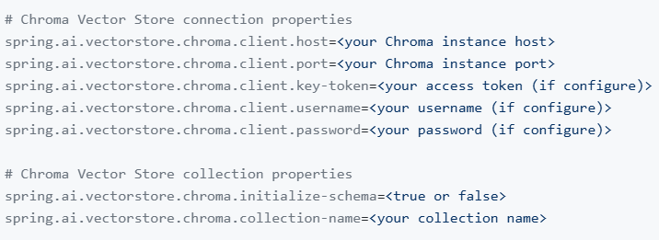
VectorStore (cont.)
Chroma is the open-source embedding database. It allows to store document embeddings, content, and metadata and to search through those embeddings, including metadata filtering.
The vector store implementation can initialize the requisite schema for you, but we must opt-in by specifying the initializeSchema boolean in the appropriate constructor or by setting ​initialize-schema=true in the application.properties file. To connect to Chroma you need to provide access details for your instance.
A simple configuration can either be provided via Spring Boot’s application.properties

Slide 54
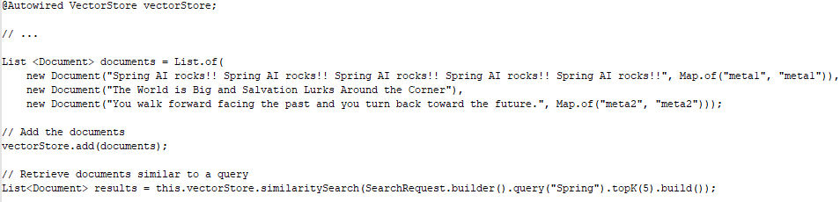
VectorStore (cont.)
We can auto-wire the Chroma Vector Store in your application and use it.

Slide 55
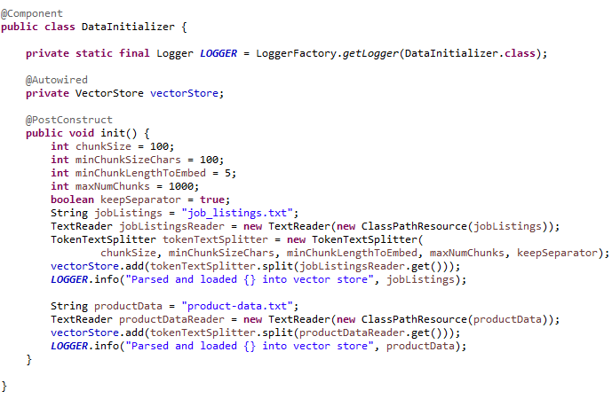
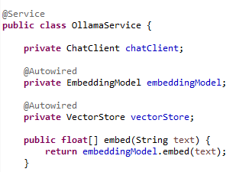
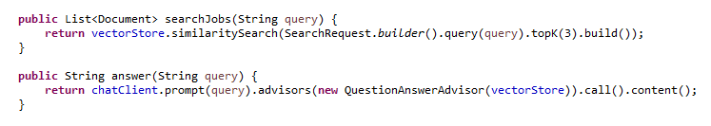
VectorStore (cont.)

Slide 56
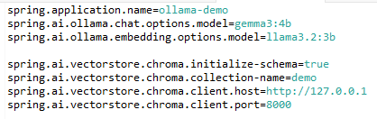
VectorStore (cont.)
In application.properties we have different properties where we define the models used for chating, embedding and vector store.

Slide 57
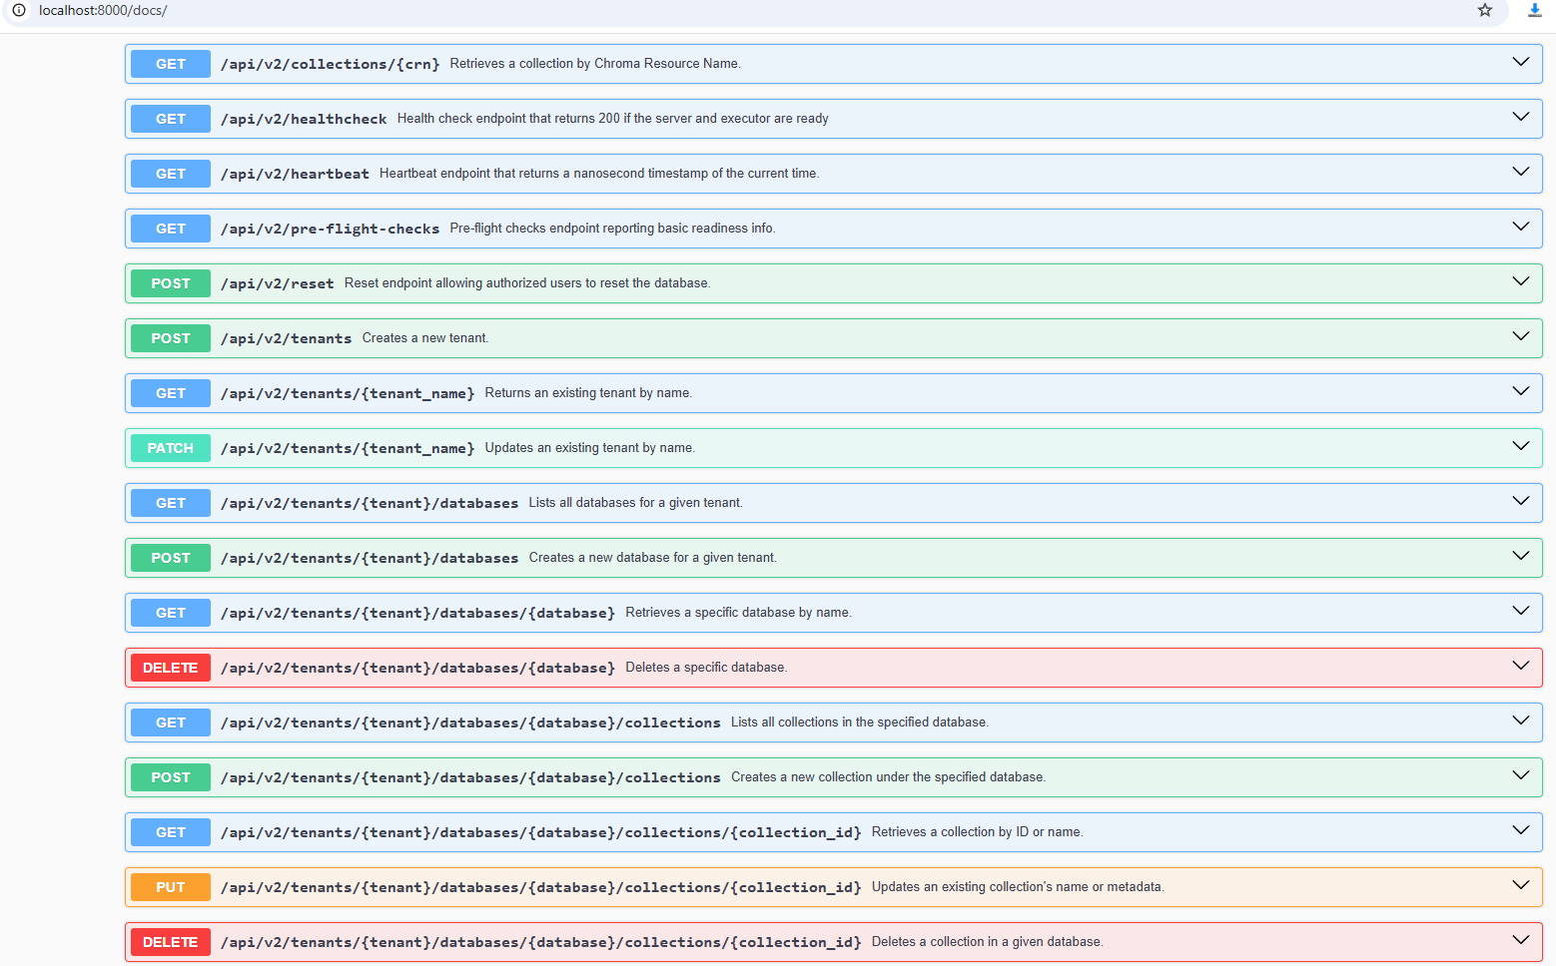
VectorStore (cont.)
We can use docker chromadb image to create a container where CromeDB is deployed by default on port 8000.
docker run -it --rm --name chroma-1.0.21 -p 8000:8000 chromadb/chroma:1.0.21.dev64
We can Access http://localhost:8000/docs to check the endpoints.

Slide 58
MCP
The Model Context Protocol (MCP) is a standardized protocol that enables AI models to interact with external tools and resources in a structured way.
It supports multiple transport mechanisms to provide flexibility across different environments.
The MCP Java SDK provides a Java implementation of the Model Context Protocol, enabling standardized interaction with AI models and tools through both synchronous and asynchronous communication patterns.

Slide 59
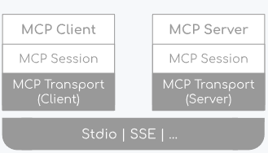
MCP (cont.)
The Java MCP implementation follows a three-layer architecture:
Client/Server Layer: The McpClient handles client-side operations while the McpServer manages server-side protocol operations. Both utilize McpSession for communication management.
Session Layer (McpSession): Manages communication patterns and state through the McpClientSession and McpServerSession implementations.
Transport Layer (McpTransport): Handles JSON-RPC message serialization and deserialization with support for multiple transport implementations.

Slide 60
MCP (cont.)
The MCP Client is a key component in the Model Context Protocol (MCP) architecture, responsible for establishing and managing connections with MCP servers.
It implements the client-side of the protocol, handling:
Protocol version negotiation to ensure compatibility with servers
Capability negotiation to determine available features
Message transport and JSON-RPC communication
Tool discovery and execution
Resource access and management
Prompt system interactions
Synchronous and asynchronous operations
Transport options:
Stdio-based transport for process-based communication
Java HttpClient-based SSE client transport
WebFlux SSE client transport for reactive HTTP streaming

Slide 61
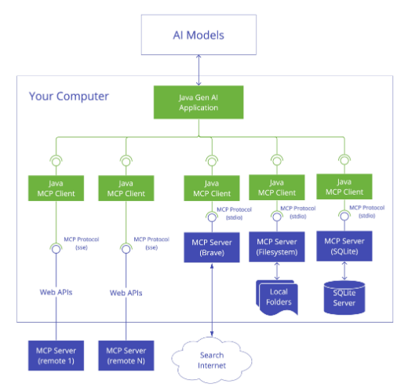
MCP (cont.)

Slide 62
MCP (cont.)
The MCP Server is a foundational component in the Model Context Protocol (MCP) architecture that provides tools, resources, and capabilities to clients.
It implements the server-side of the protocol, responsible for:
Server-side protocol operations implementation
Tool exposure and discovery
Resource management with URI-based access
Prompt template provision and handling
Capability negotiation with clients
Structured logging and notifications
Concurrent client connection management
Synchronous and Asynchronous API support
Stdio-based transport for process-based communication
Servlet-based SSE server transport
WebFlux SSE server transport for reactive HTTP streaming
WebMVC SSE server transport for servlet-based HTTP streaming

Slide 63

MCP (cont.)

Slide 64
MCP (cont.)
Spring AI provides MCP integration through the following Spring Boot starters:
Client Starters
spring-ai-starter-mcp-client - Core starter providing STDIO and HTTP-based SSE support
spring-ai-starter-mcp-client-webflux - WebFlux-based SSE transport implementation
Server Starters
spring-ai-starter-mcp-server - Core server with STDIO transport support
spring-ai-starter-mcp-server-webmvc - Spring MVC-based SSE transport implementation
spring-ai-starter-mcp-server-webflux - WebFlux-based SSE transport implementation

Slide 65


MCP (cont.)
Maven pom.xml setup:

Slide 66

MCP (cont.)
We need to define the Spring Boot Application

Slide 67

MCP (cont.)
For the Weather service, we use the define a @Service bean class and use the @Tool annotation to define the exposed methods.

Slide 68

MCP (cont.)

Slide 69


MCP (cont.)

Slide 70
MCP (cont.)
To start the MCP Server developed with Spring AI we need to use the following command::
java -Dspring.ai.mcp.server.stdio=true Dspring.main.web-application-type=none -Dspring.main.banner-mode=off -Dlogging.level.root=OFF -jar target/weather-mcp-server-0.0.1-SNAPSHOT.jar
This will start the Weather Spring application in STDIO mode.
By default the microservice starts in WebMVC SSE mode.

Slide 71

MCP (cont.)
We can test the MCP server by using a MCP client

Slide 72
Conclusion
Pros:
Seamless integration
Unified AI API
Ease of development
Extensibility
Cons:
Learning Curve
Requires setup
Resource intensive

Slide 73

Bibliography
https://spring.io/projects/spring-ai
Udemy – A step by step guide to master Spring AI
Udemy – MCP Crash Course Complete Model Context Protocol in a Day
https://github.com/spring-ai-community/awesome-spring-ai

